Slide 1

Python Level 2
882.33
Lesson 2: Building libraries

Slide 2
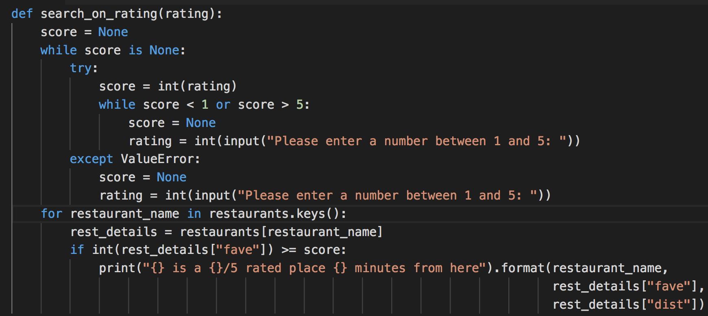
Revisiting Last Week
Missed Last week? http://eca-python/level2lesson2

Slide 3

What now?
Being able to ensure a number is between bounds might be useful in other places:
Cost is rated 1-5 too!
Negative numbers for distance, maybe?
Write a function that does this instead
It should take 3 arguments: lower and upper bounds, value to check

Slide 4
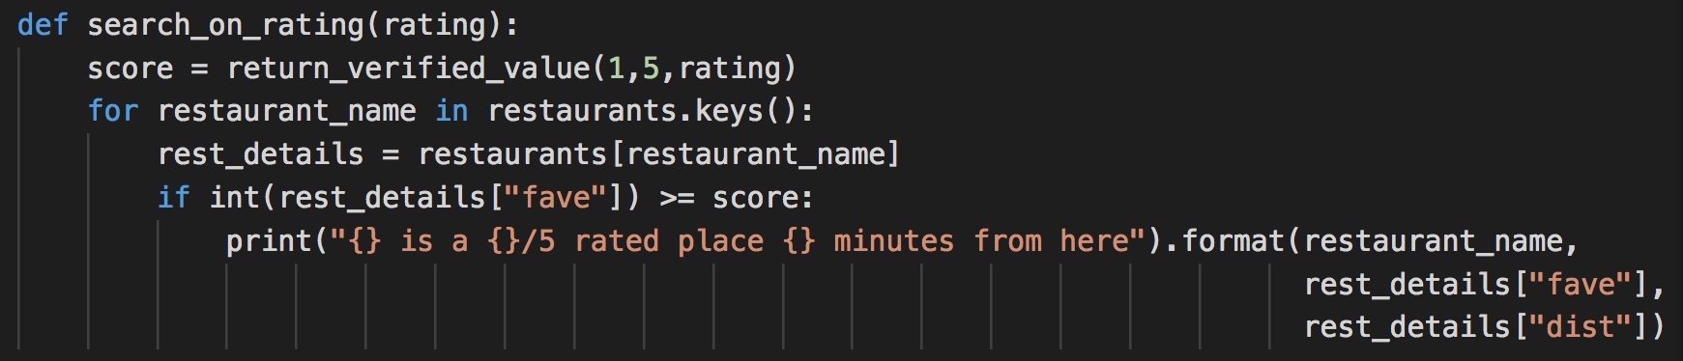
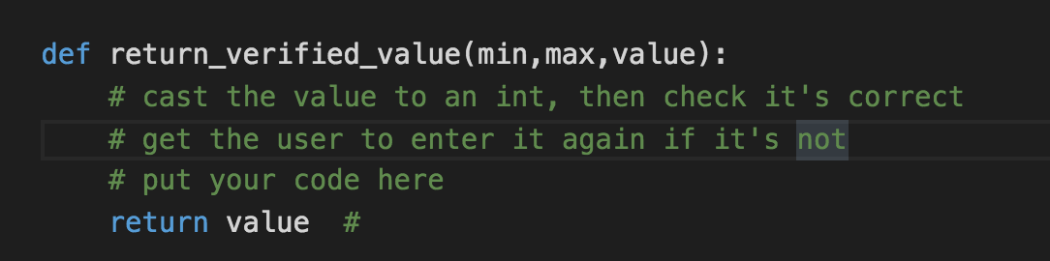
Verifying a Value
Here’s a hint:

Slide 5
Just in case…
That if statement to select from the main menu is getting pretty unwieldy
Any suggestions?

Slide 6
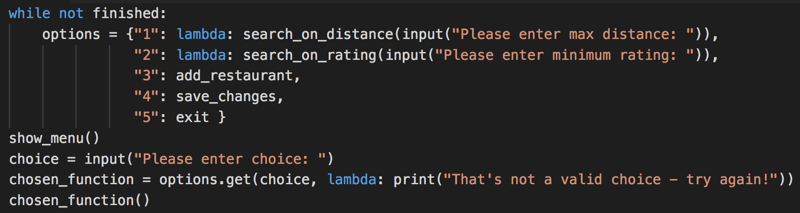
Sacrificial lambda
A lambda is an expression that’s treated as if it were a function.
What happens if we miss the lambda keyword out?
What do the last two lines do?
Functions are stored in variables – just like values!
There’s one major advantage gain by using a dictionary as a case statement. What is it?

Slide 7
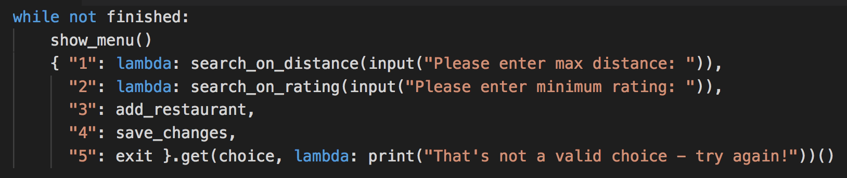
And what about this?
There’s more than enough evil in the world. Don’t do this.

Slide 8
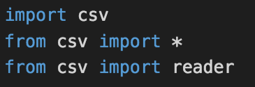
Back to the point
Remember these?
What do each of them do?
What does running pydoc csv tell you?
Windows users: you might need python -m pydoc csv

Slide 9
Building a (small) library
Move your return_verified_value() function to a separate file (in the same folder).
Call your file “shared.py”.
How can you call return_verified_value() now?
What happens in the folder when you run your program?
What can pydoc tell you about your new file?

Slide 10
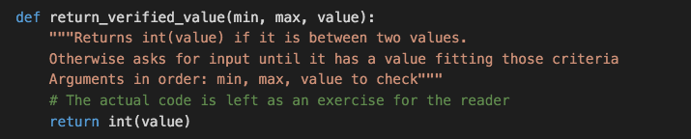
Taking the Doc to the library
What does the triple-quoted string do?

Slide 11
Bonus points / Homework…
Move the load / save CSV functions to your function library file
What sort of problems do we encounter when we do this?
Next week: getting classy

